Slide 1
Entering this area implies you have given consent for your likeness to be used in future FIRST materials
FIRST requires all youth team members to register. Youth Team Members who have not registered will not be permitted to compete in FIRST events or competitions.

Slide 2


Slide 3
AGENDA
8:30 AM
AZFirst Remarks
10:00 AM
Broadcast Begins (12PM ET)*
11:00 AM
Kit Hand-out
Doors Open
9:00 AM
Arizona Robotics League
Alumni Engagement
Si Se Puede Foundation
GO BUILD!
*Times subject to change based on broadcast*

Slide 4
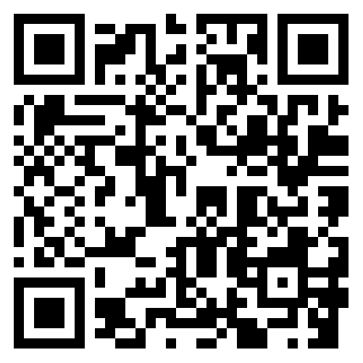
Arizona Alumni Group
Grace Rosenvall
gcrosenvall@gmail.com
For current FIRST alumni: Get connected to our newsletter by scanning the QR code.

Slide 5
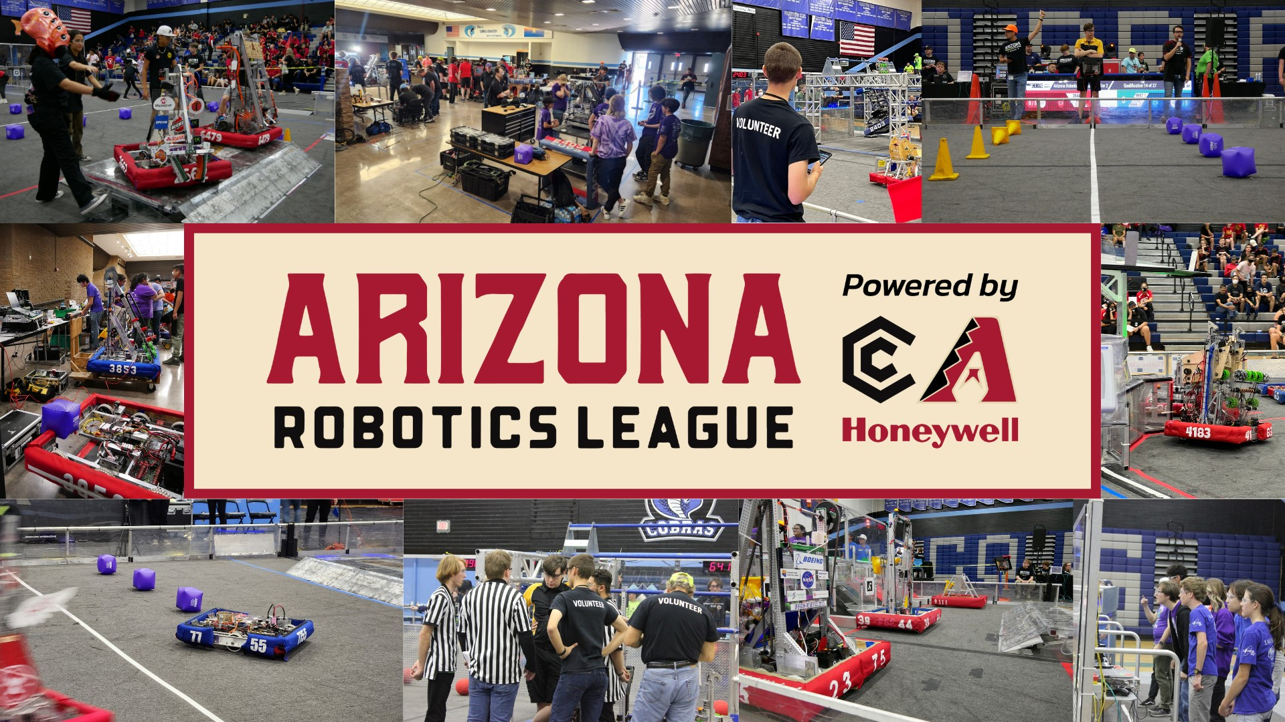

Slide 6
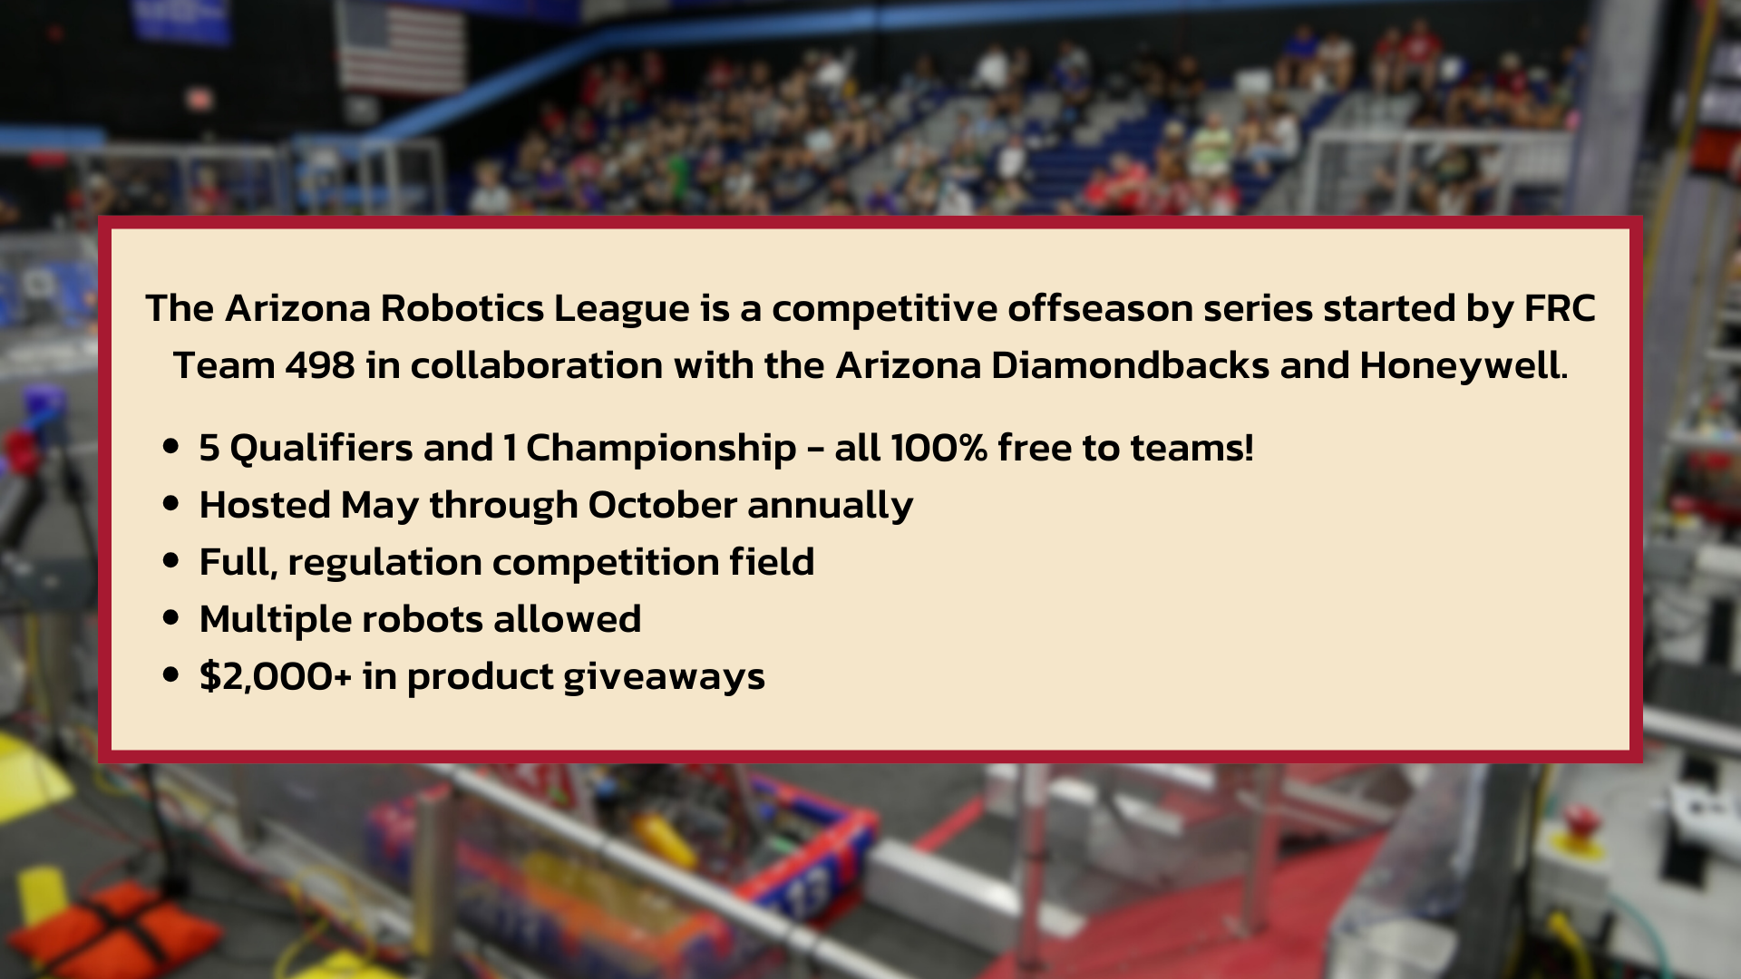

Slide 7
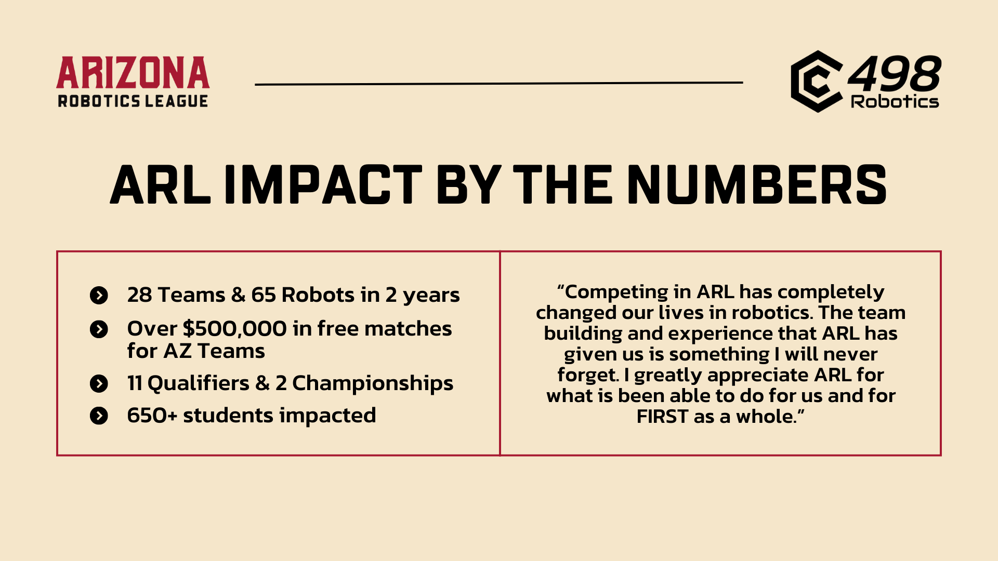

Slide 8
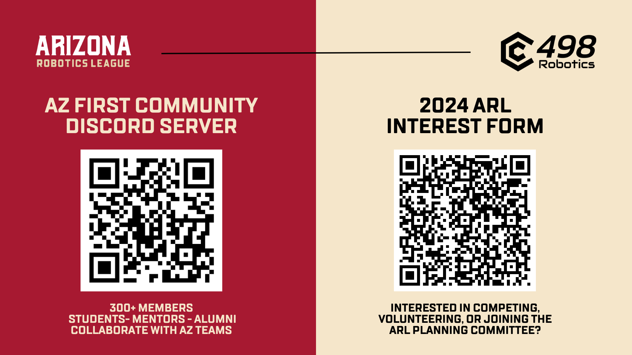

Slide 9
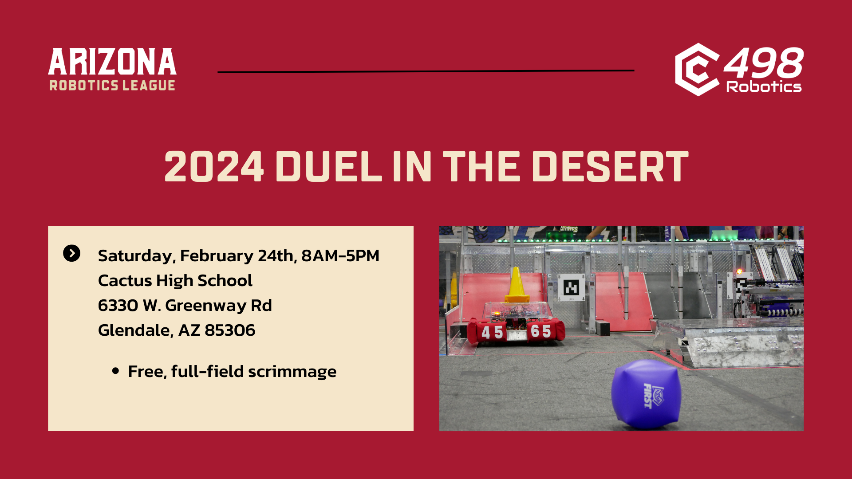

Slide 10
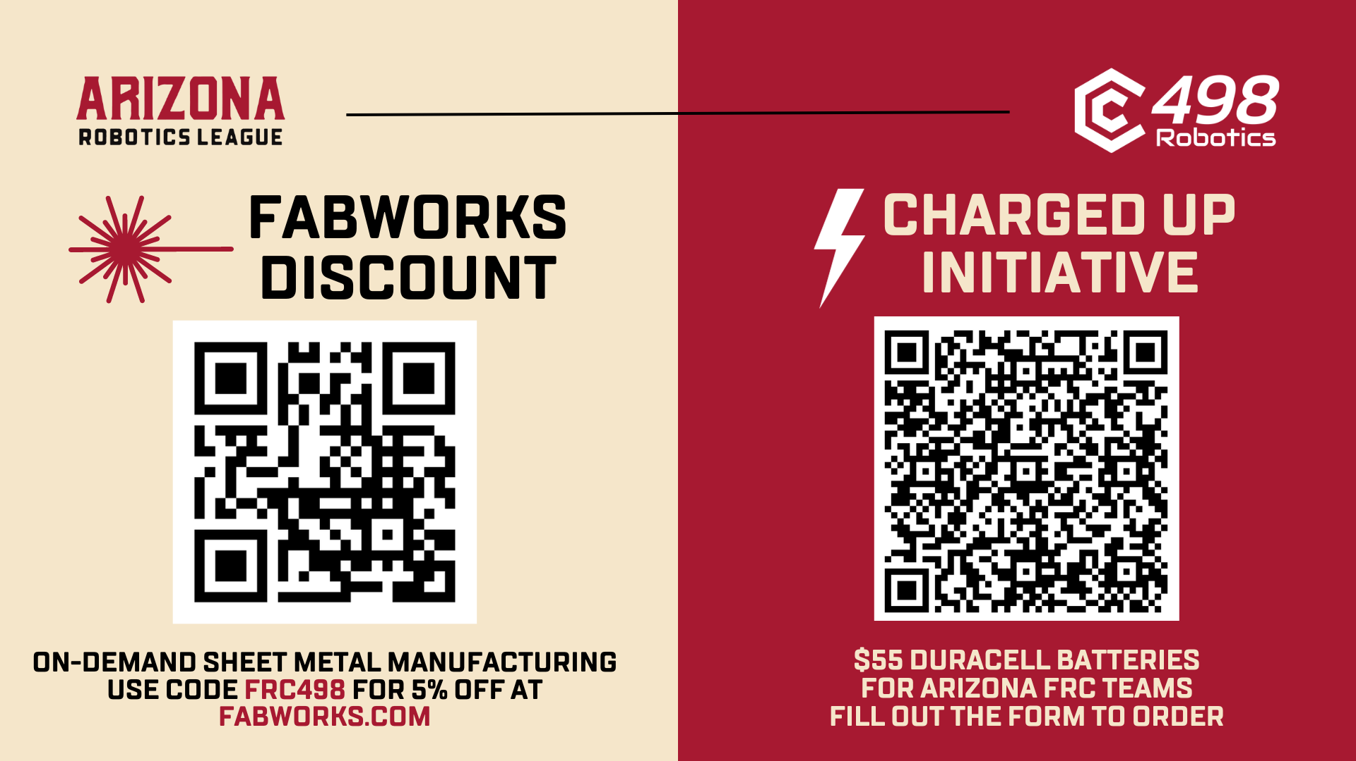

Slide 11
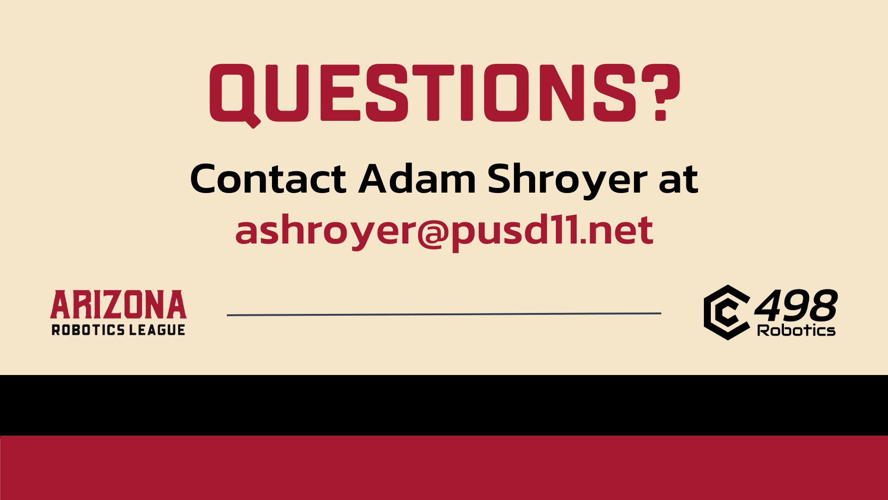

Slide 12



Slide 13
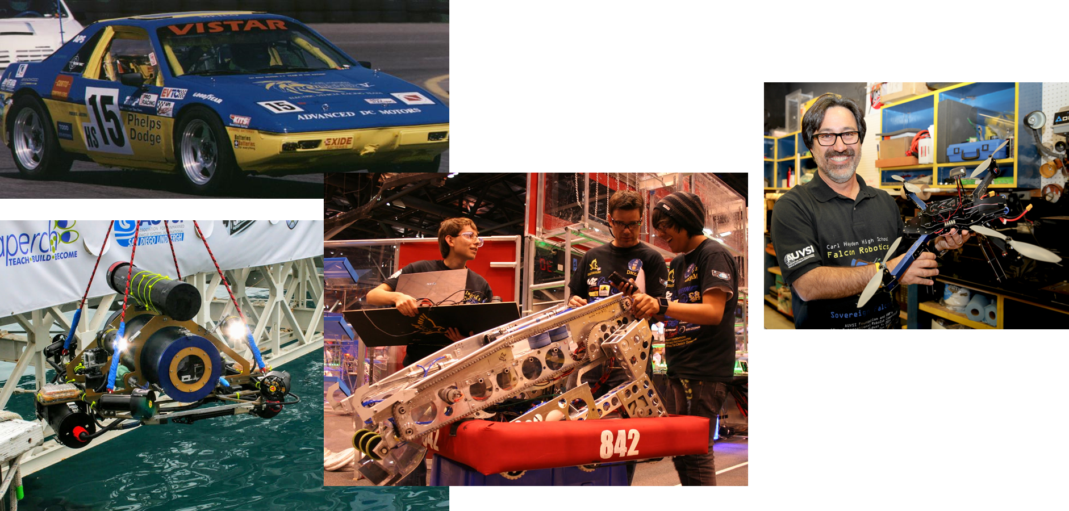
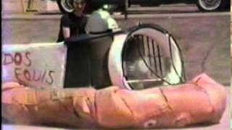
My background
30 Years in public education
6 Years scale and full-sized hovercraft
10 years full sized electric vehicle racing
14 years under water robotics
22 years in FIRST robotics
Currently CEO/ President of
the Si Se Puede Foundation

Slide 14



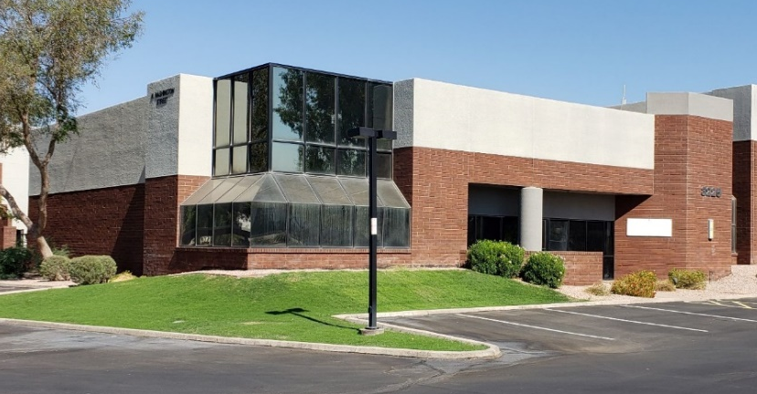
SSPF STEM Center
The foundation opened a 5,200 sq ft STEM center to serve the community. The mission of the center is to bridge the STEM divide throughout the valley. It currently serves high school and college students from over 20 schools.

Slide 15
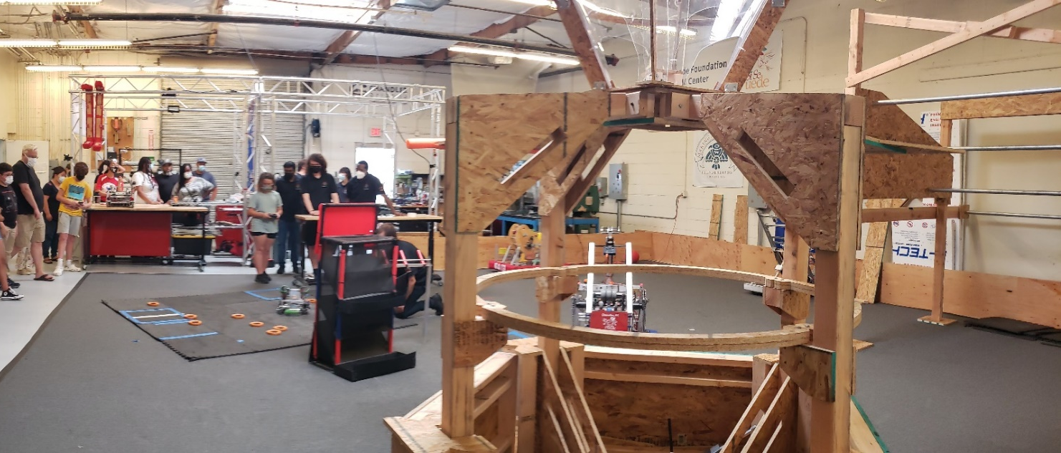

Fabrication Laboratory ½ FRC Playfield
½ FRC Field with 16-foot-high ceiling
Official FRC carpet

Slide 16
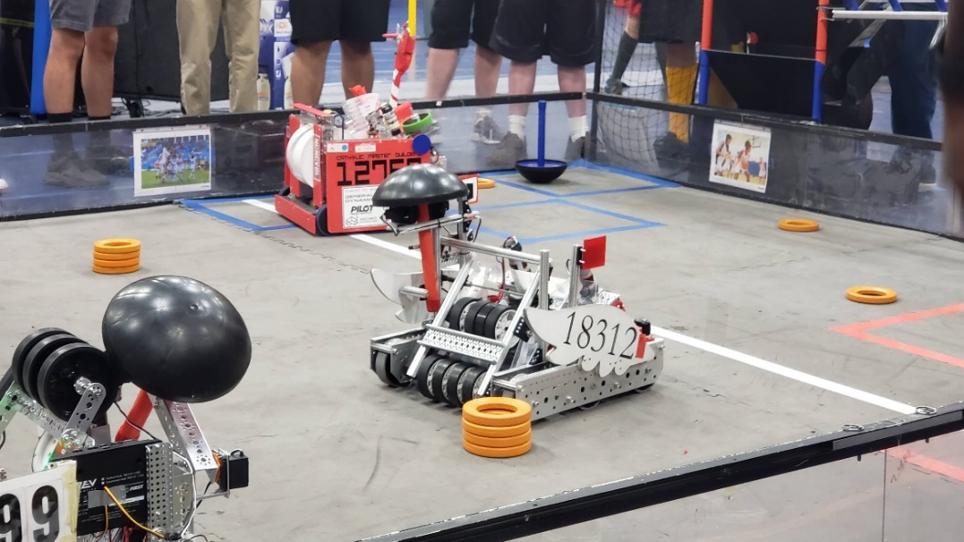

Fabrication Laboratory FTC Playfield
FTC field with perimeter

Slide 17
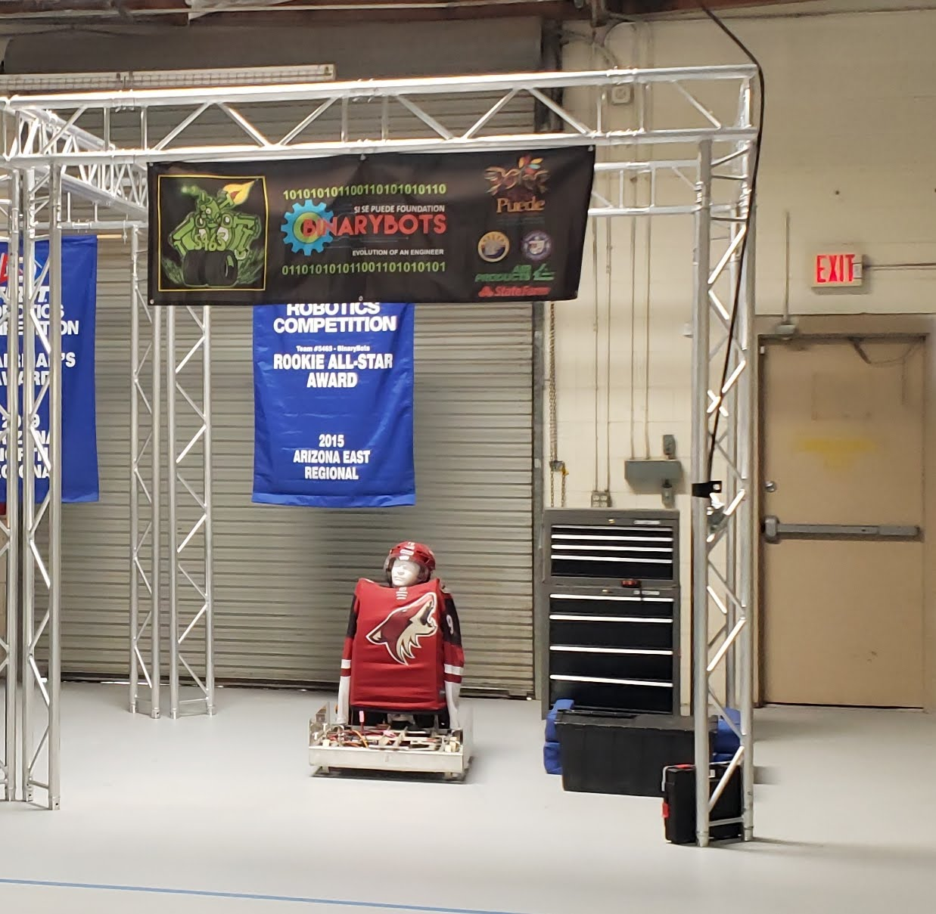

Fabrication Laboratory Guest Pit
10’ X 10’ aluminum truss
Electrical drop
Two rolling tool cabinets with tools
For use while using practice field
Test pit set-up
Workspace for guest team while at SSPF STEM Center

Slide 18
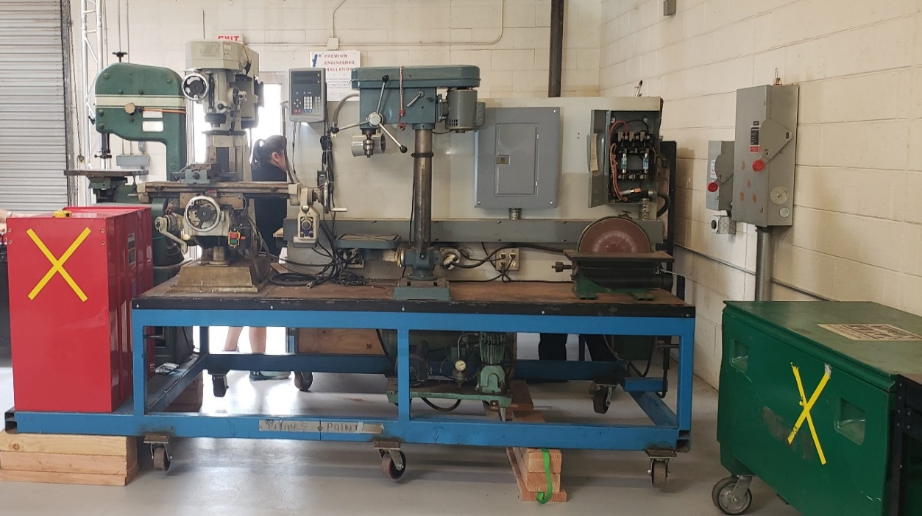

Fabrication Laboratory AZFirst Machine Shop
Portable Machine Shop
Press
Mill
Drill Press
Lathe
Compressor

Slide 19
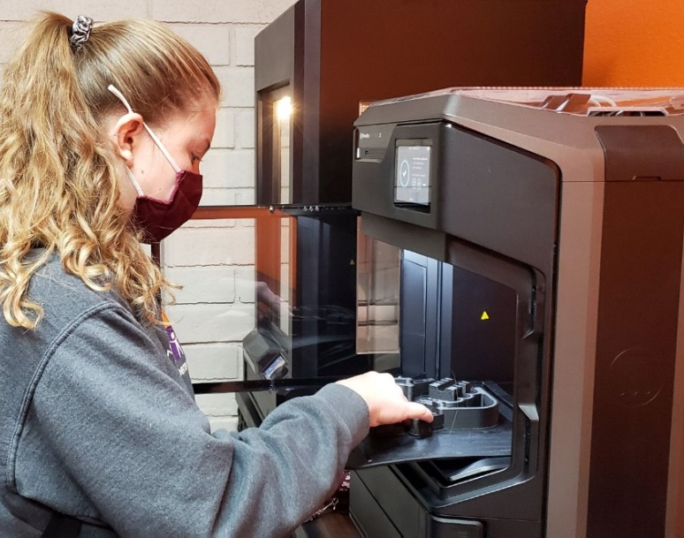
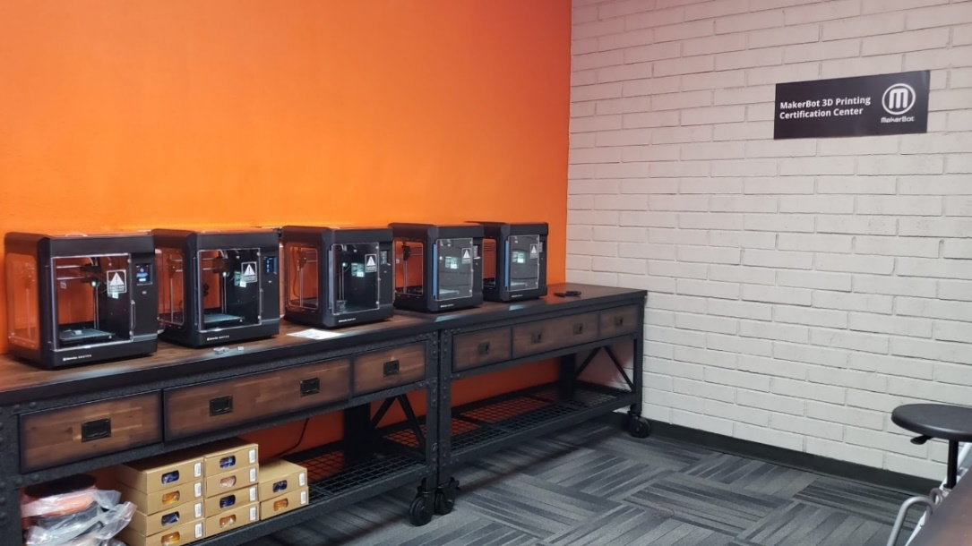

3D Printers
5 Makerbot Sketch 3D printers, 1 Z-18 printer, 1-Method Printer

Slide 20
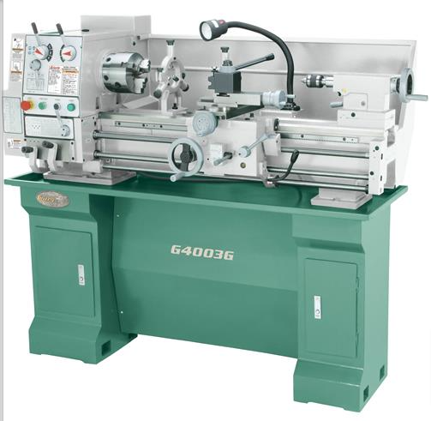

Fabrication Laboratory Lathe
Motor: 2 HP
Swing: 12 in.
Distance between centers: 36 in.
Spindle bore: 1.57 in.
Spindle type: D1-5 Camlock
Speeds: 70 – 1400 RPM
Tailstock taper: MT#3
Tailstock barrel travel: 4 in.

Slide 21
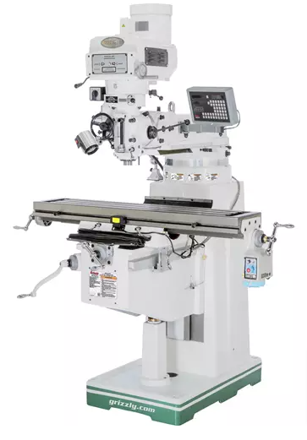


Fabrication Laboratory Mill
Motor: 3 HP
Table size: 50 in. x 10 in.
Longitudinal travel: 30 in.
Cross travel: 14 in.
Spindle taper: R-8
Number of speeds: Variable
Max spindle to table: 19-1/4 in.
Max spindle to column: 27-1/2 in.

Slide 22
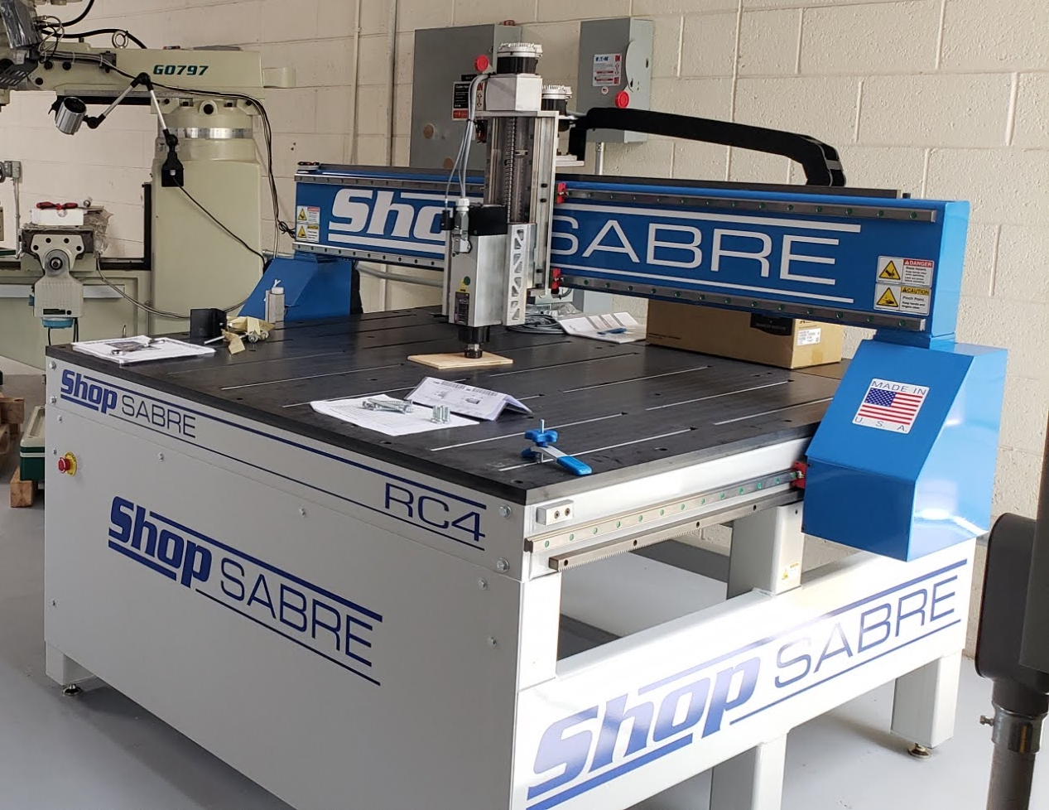
Fabrication Laboratory CNC Router
Footprint: 79" x 68" x 69" (with Tool Changer 78")
Cut Area: 51" x 49"
Z Clearance: 8"
Z Travel: 9"
Rapid Speed: 1300IPM Standard
Repeatability: +/-.002"
Drive Motors: Servo Motors with Planetary Gears

Slide 23
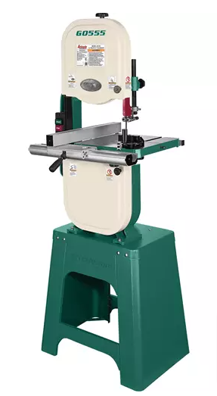
Fabrication Laboratory Band Saw
Motor: 1 HP
Max cutting width: 13-1/2 in.
Max cutting height: 6 in.
Table size: 14 in. x 14 in.
Wheel type: Computer-Balanced Cast Aluminum
Blade size: 93-1/2 in.
Quick blade change: Yes
Overall height: 66-1/2 in.

Slide 24
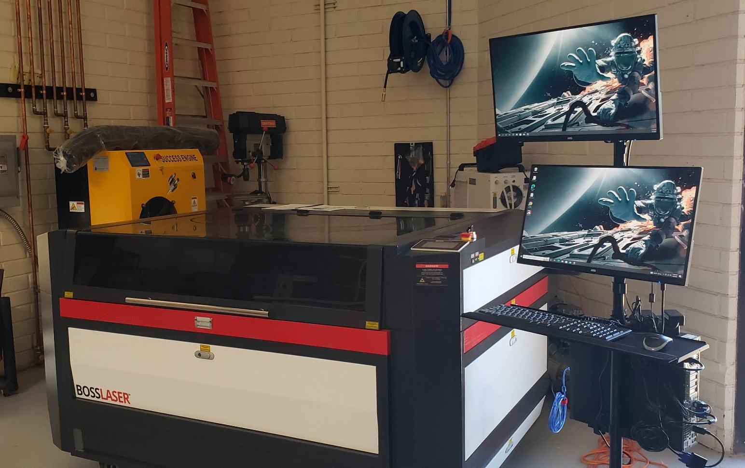
Fabrication Laboratory LASER cutter
Cutting Area: 55” x 35 “
105 Watts
Organics / non-metals + Pre-treated metals
Air Filtration System
LightBURN software

Slide 25
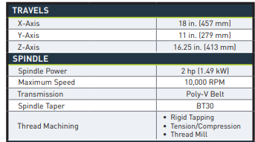
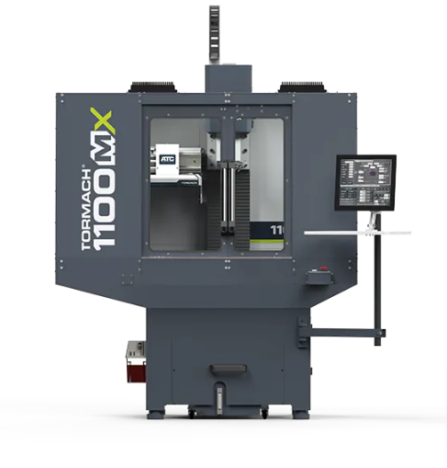
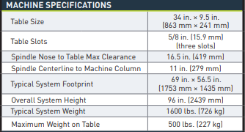
Fabrication Laboratory CNC Mill

Slide 26
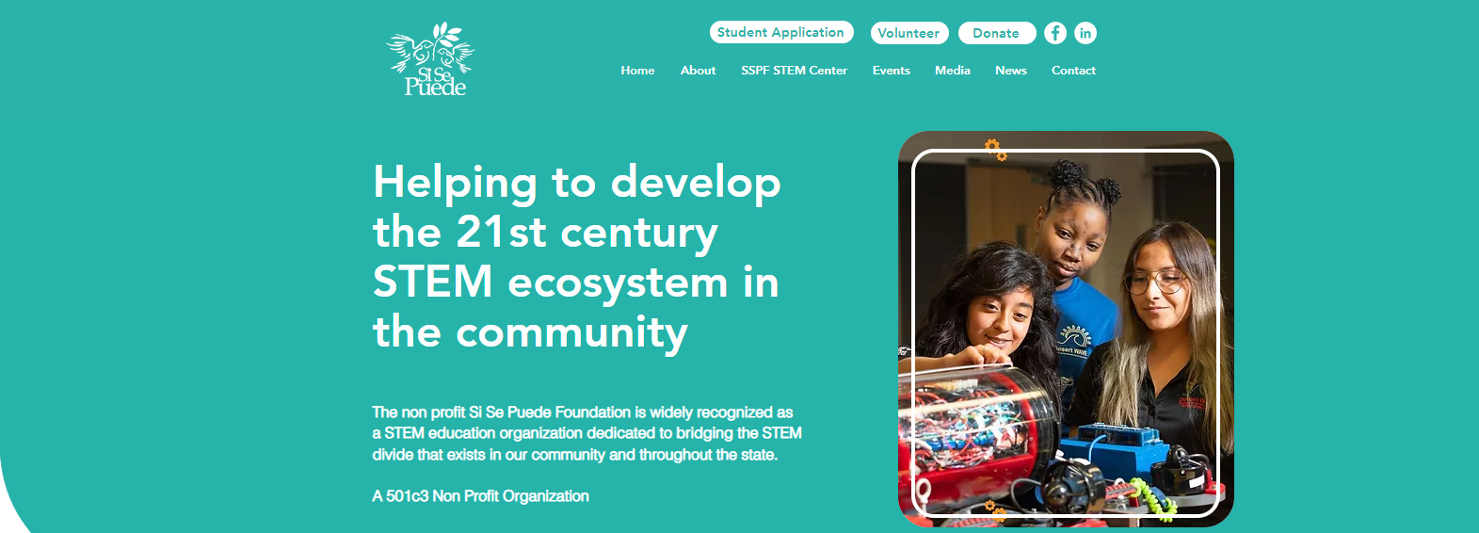
Website sisepuedefoundation.org

Slide 27
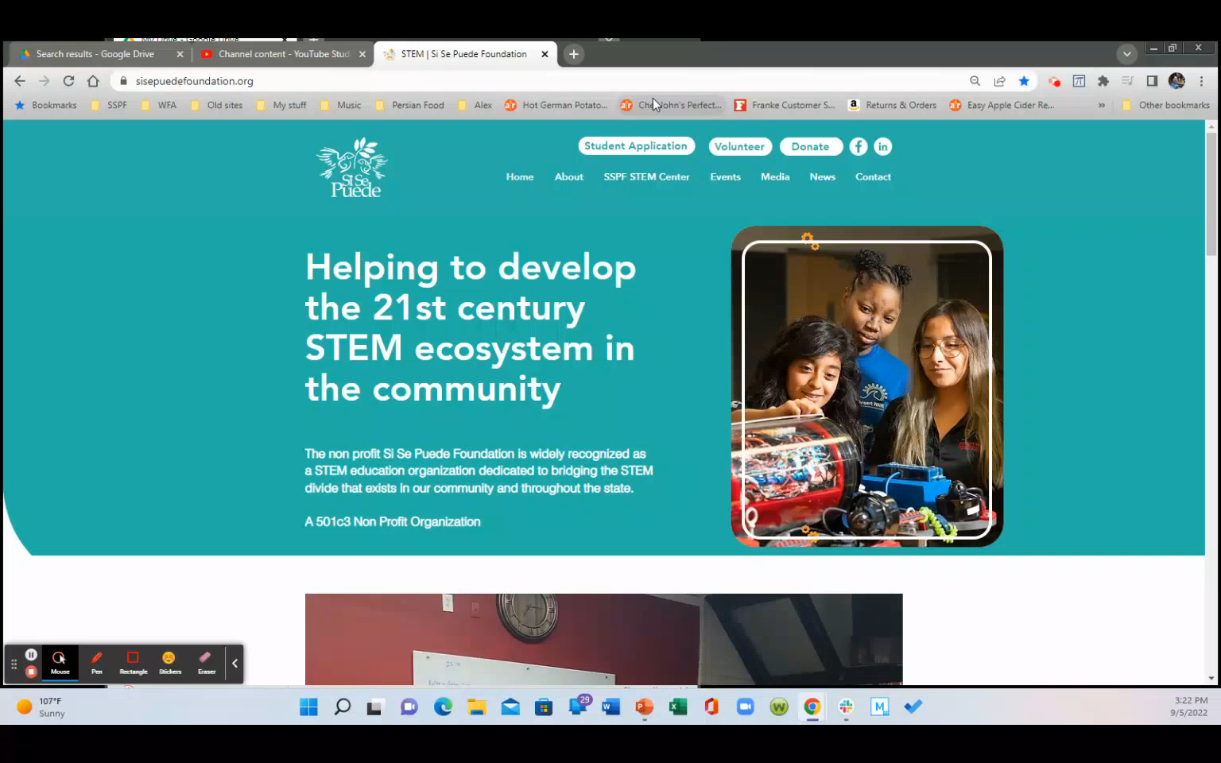
Website sisepuedefoundation.org

Slide 28

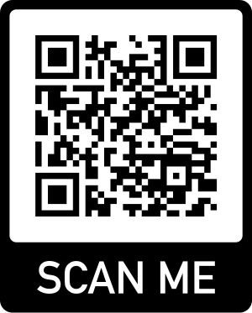
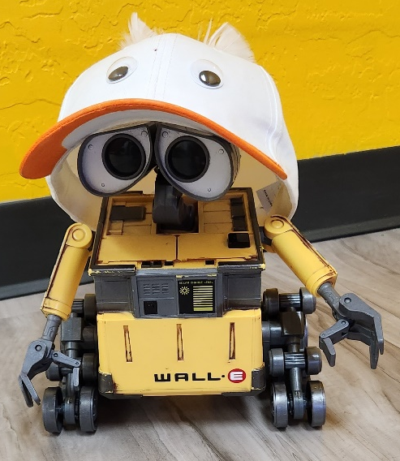
Need assistance with your robot? No autonomous code? Leak in your pneumatics? Mechanism isn’t working? The Beak Squad is here to help! Our experienced students and mentors are happy to work with your team to make sure your robot competes at its best.
Teams are welcome to schedule a time to visit us at the SSPF STEM Center, or we can visit you at your build site!
We Can Help With:
Mechanical and Electrical
Fixing electrical connections
Lending robot parts and tools
Mechanism repair
Tool training
Programming
Developing autos
Code to make mechanisms run
Troubleshooting code issues

Slide 29
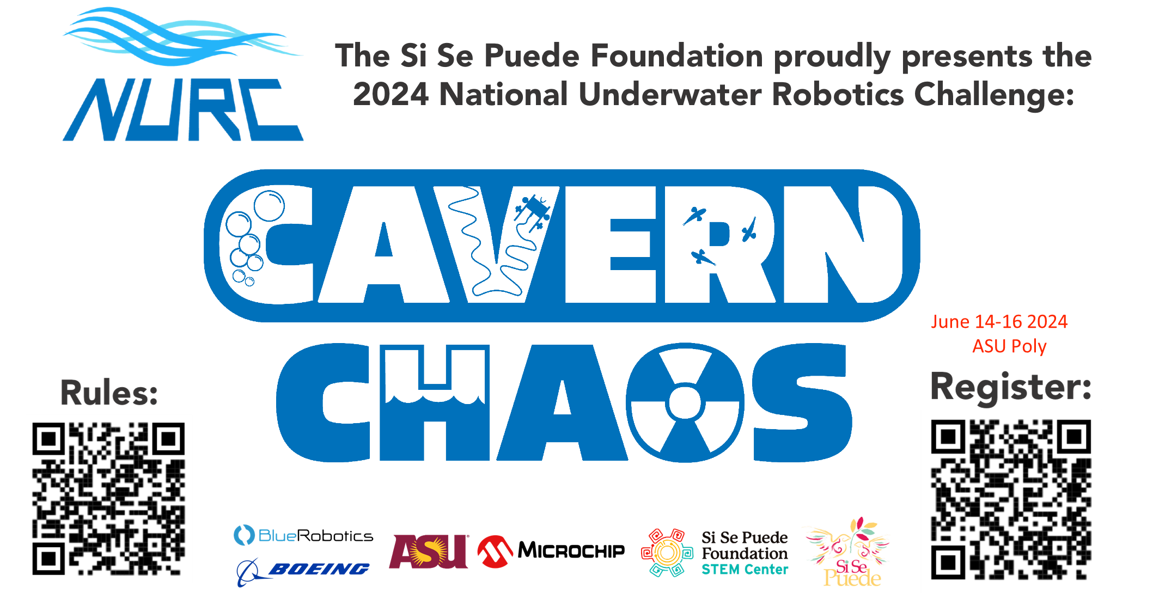

Slide 30
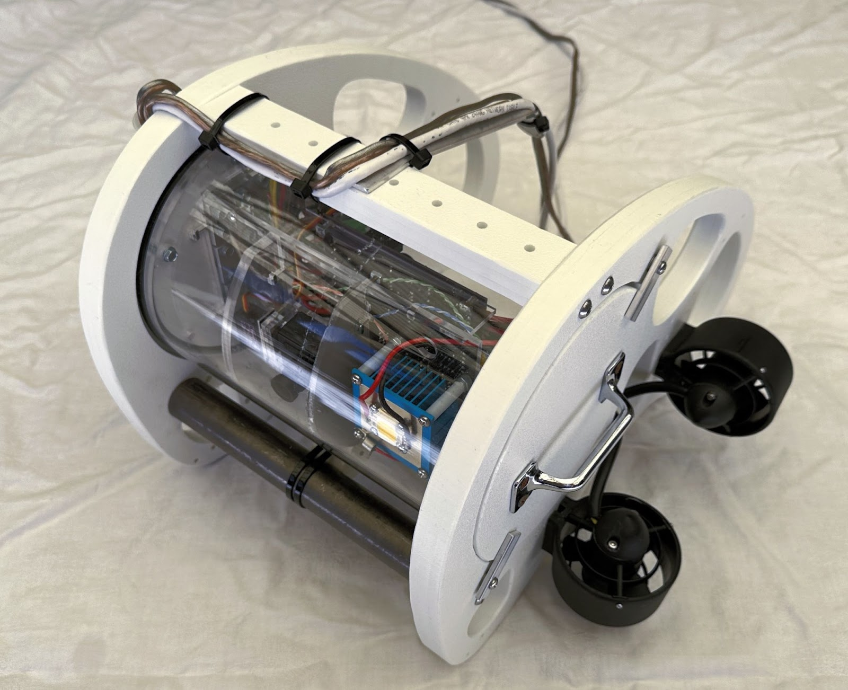


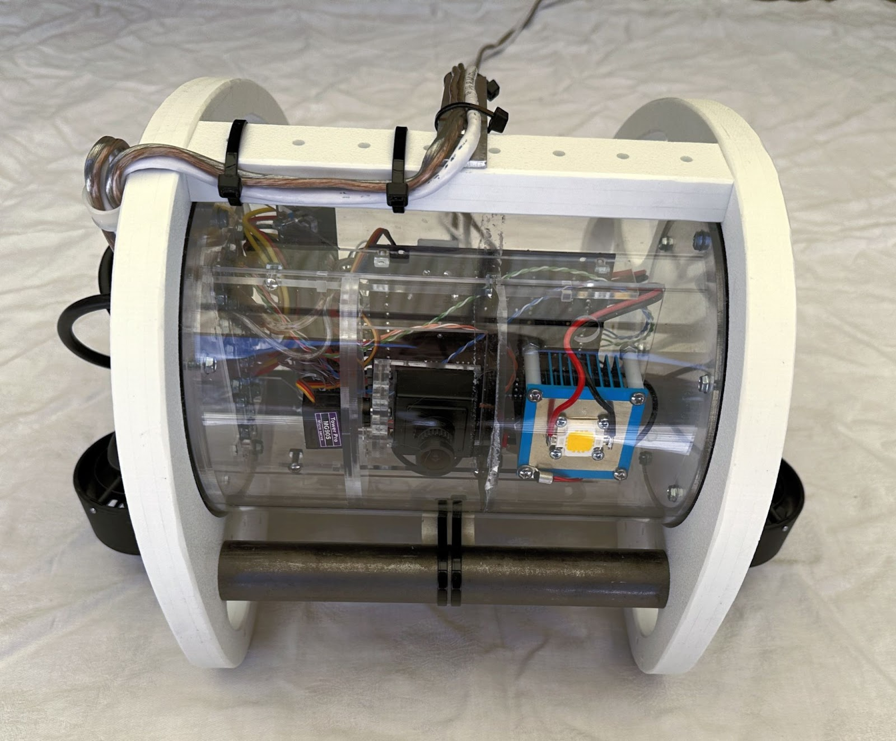
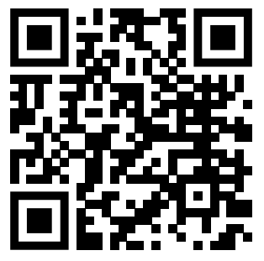
NURC ROV KIT
Basic Model Cadet - $750
(Two 12 V 18AH FRC style batteries and analog monitor (yellow RCA plug) or analog to HDMI adaptor, not included)
4 Thrusters- Apisqueen U2 Mini 1.3KG thrust 16V 130W
4 ESCs
Control board- Rovotron RVCBOT
Main hull- 6” cast acrylic
Frame- ½” HDPE
Operator interface- Rovotron ROVLink
Tether- 50’ ethernet cable
Controller- Xbox Gamepad
Upgraded Cadet - $900
(includes basic model Cadet with addition of)
Grabber- Rovotron Grabber
1 thruster- Apisqueen U2 Mini 1.3kg thrust 16v 130W
1 ESC
More Info & Pre-Order

Slide 31

Thank you!
Any Questions?
Fredi.lajvardi@sisepuedefoundation.org

Slide 32
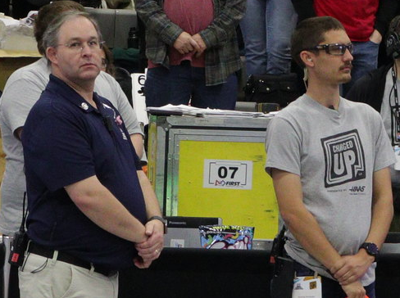
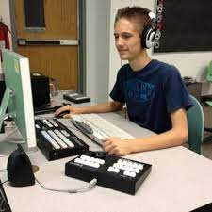
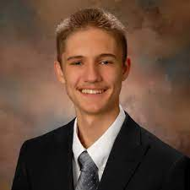
Welcome
Jeremy Knutson, NEW FIRST FTA

Slide 33
Thanks to our sponsors, through their donations, we have the funds to put on the Arizona Regional events.
No team registration fees are applied to expenses for the regional events.

Slide 34




Where do Registration Fees go?
To FIRST Headquarters for…
FIRST expenses for the game
Kit of Parts, valued at ~$18,000
Playing field FIRST ships to each regional ($175,000 per field)
Transport equipment to all events
Game Pieces for each field (different each year)
Field Management System for each regional (~$75,000 per FMS)
None of the registration fee cover costs to hold Arizona FRC Regional events
Our Local Sponsors cover those costs. Thank you to our local sponsors!

Slide 35






Chaparral High School & Firebird Robotics
Corona del Sol High School & The AZTECHS
Steve and Maria Sanghi
Microchip Employees
(UW donations)

Slide 36
Over
$95 Million
in scholarship opportunities available!
www.firstinspires.org/scholarships

Slide 37
Steve Sanghi Scholarship
&
Moorthy Family Inspiration Scholarship
  Students participating in AZ Regional events can apply for each scholarship
  $5,000 per year renewable for 4 years
    4 total recipients; 2 per AZ Regional
  Study engineering, science, or mathematics
  Applications due by Feb. 23 to AZFirst
  https://www.azfirst.info/frc/

Slide 38
Arizona Teacher of the Year Award
Students nominate their teacher
One teacher at each Arizona Regional will receive award
Essay due by Feb. 23 to AZFirst
  https://www.azfirst.info/frc/

Slide 39
Thanks to
Team 4146
The Sabercats
Saguaro High School
Kickoff Host

Slide 40
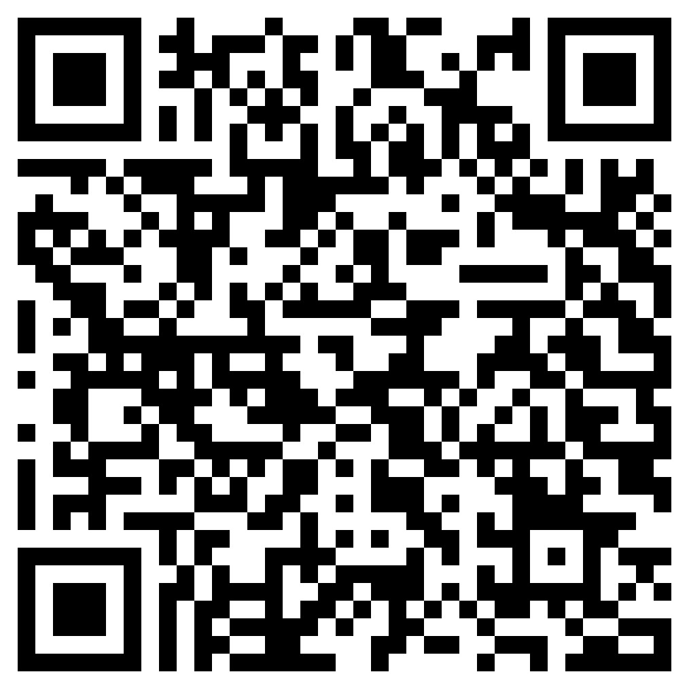
And our workshop presenters
Please provide your feedback by scanning the QR code above

Slide 41
Thanks to
Our Volunteers
It takes over 100 volunteers to put on each FRC AZ Regional!
Want to volunteer or know someone that might??
www.firstinspires.org/ways-to-help/volunteer

Slide 42
Update your sponsor information
FIRST Team Support available TODAY
1-800-871-8326
Team Dashboard by Jan. 8
or
(603) 666-3906, ext. 0

Slide 43
Important Dates
Jan. 24 (5:00pm EST)
Additional Event Payment Deadline
Feb. 8 (3:00pm EST)
Dean’s List application and Woodie Flowers submissions
Feb. 15 (3:00pm EST)
Impact Award submission
Feb. 23
Sanghi and Moorthy Family Inspiration Scholarship Applications Due
AZ Teacher of the Year Essay due
Jan. 12 (11:59am EST)
Kit of Parts Replacement System Closes
Jan. 26 (12:00pm EST)
FIRST Choice Regular Ordering Opens

Slide 44
  Arizona Valley Regional
  Chaparral High School
  6935 E. Gold Dust Ave
  Scottsdale, AZ
  March 13-16
  Arizona East Regional
  Corona del Sol High School
  1001 E. Knox Rd
  Tempe, AZ
  March 20-23
  FIRST Championship
  Houston, TX
  April 17-20

Slide 45
Sanghi Foundation
Arizona State Championship
October 2024
Arizona State University’s
Desert Financial Arena

Slide 46
Resources for Help
FIRST Competition Handbook
READ the Manual
FIRST Technical Resources
FIRST Team Management Resources
Other Team Connections
Chief Delphi
FIRST Robotics Arizona Facebook
Arizona Robotics League Discord
Arizona FIRST Discord
Unofficial FIRST Discord

Slide 47
To Pick Up Your KoP
You need
  Team roster
  Consent and release forms (if not completed online)

Slide 48
Damaged or Missing Parts?
Do a complete inventory
Notify FIRST by 12:00PM ET on Jan. 12
You only get to order once so make sure you’ve received everything
Lead Coach/Mentor 1 or 2 logs in to team’s account
Click on the “Payments and Product” drop down menu and select “Order Replacement Parts”
Follow further directions

Slide 49
Questions?

Slide 50


Slide 51
Kit of Parts
Sign Out

